Slide 1
UNSUPERVISED LEARNING (KOHONEN NN)

Slide 2
Introduction
Proposed by Prof. Teuvo Kohonen in 1982.
Consist of neurons that compile itself based on input values in groups known as clusters
clusters that have the weight vector means having the closest distance to the input vectors will be chosen as the winner.
Winning neurons along with their neighboring will adjust their weights.

Slide 3
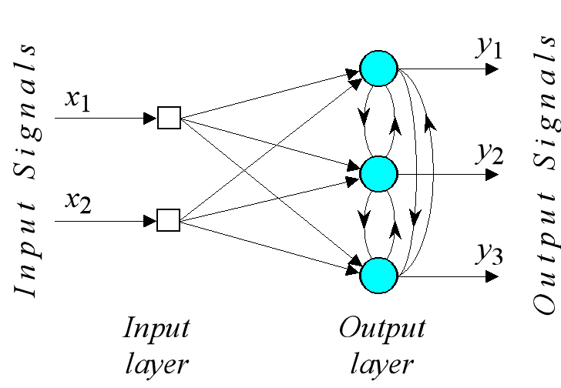
Architecture

Slide 4
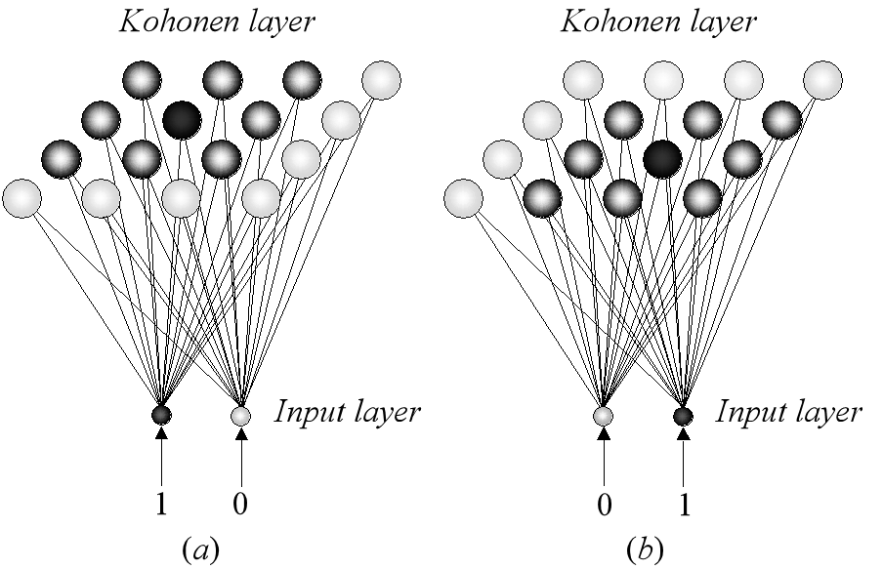

Slide 5
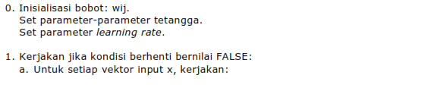
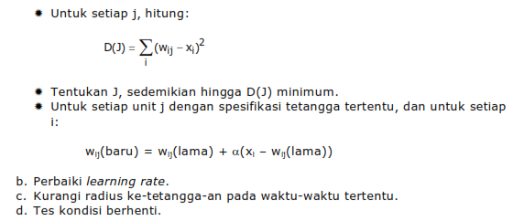
Algoritma

Slide 6
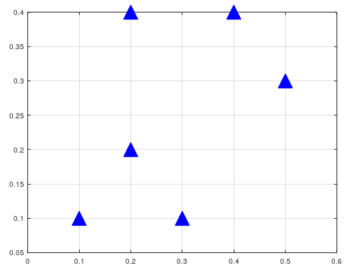
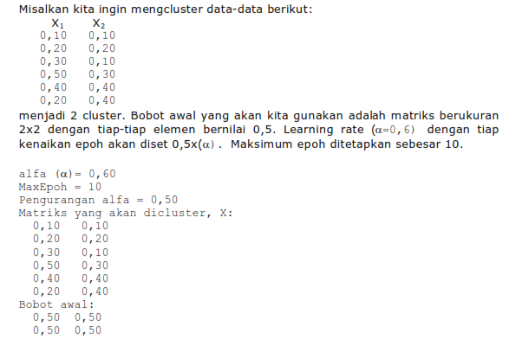
Contoh

Slide 7

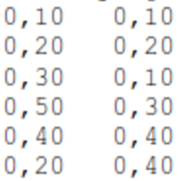
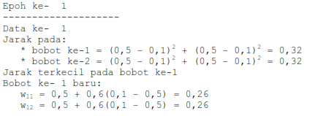



Slide 8
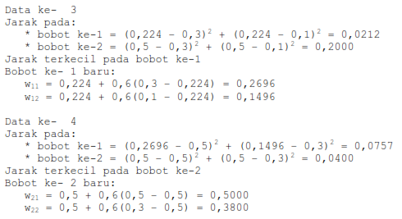

Slide 9
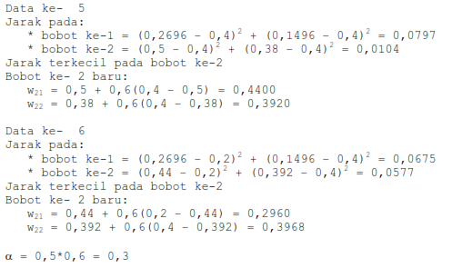

Slide 10
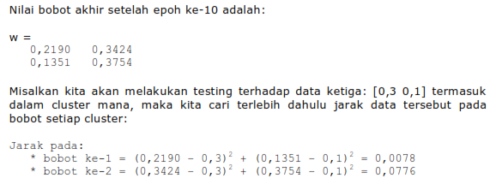
Setelah epoch ke 10

Slide 11
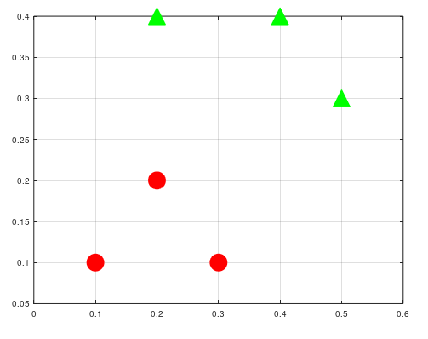
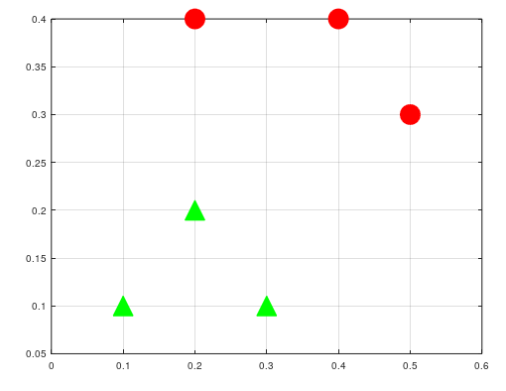
Hasil Clustering
Init W: fixed value
Init W: random

Slide 12
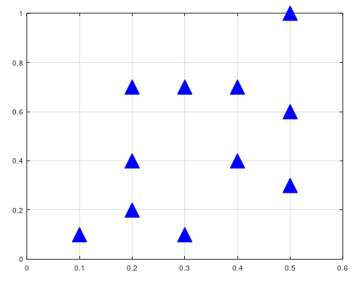
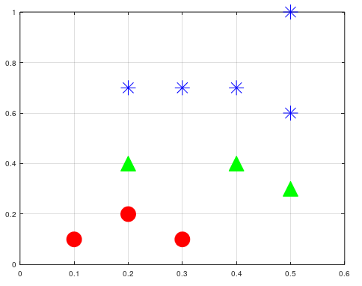
Example data dengan variasi:
X=[ 0.1 0.1;
0.2 0.2;
0.3 0.1;
0.5 0.3;
0.4 0.4;
0.2 0.4;
0.3 0.7;
0.5 0.6;
0.4 0.7;
0.2 0.7;
0.5 1]

Slide 13
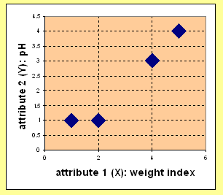
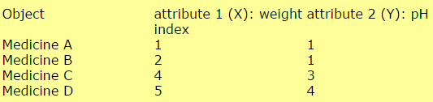
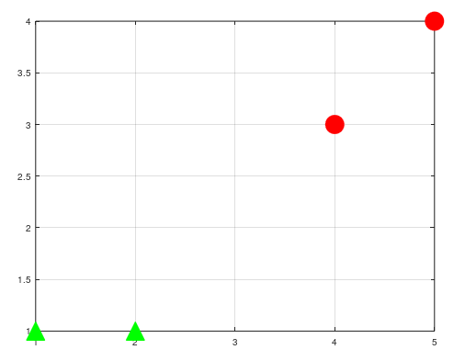
Latihan
Given 4 Objects:
Tentukan cluster dari data di atas
W_{init}=[0 0;
0 0]
W_{out}=[4.45490 3.47155
1.14513 0.73978]

